Slide 1

A Comprehensive Guide for Beginners
Introduction to Data Analysis
Learn the fundamentals, tools, and techniques to extract meaningful insights from data
Introduction to Data Analysis
Slide 1 of 12

Slide 2


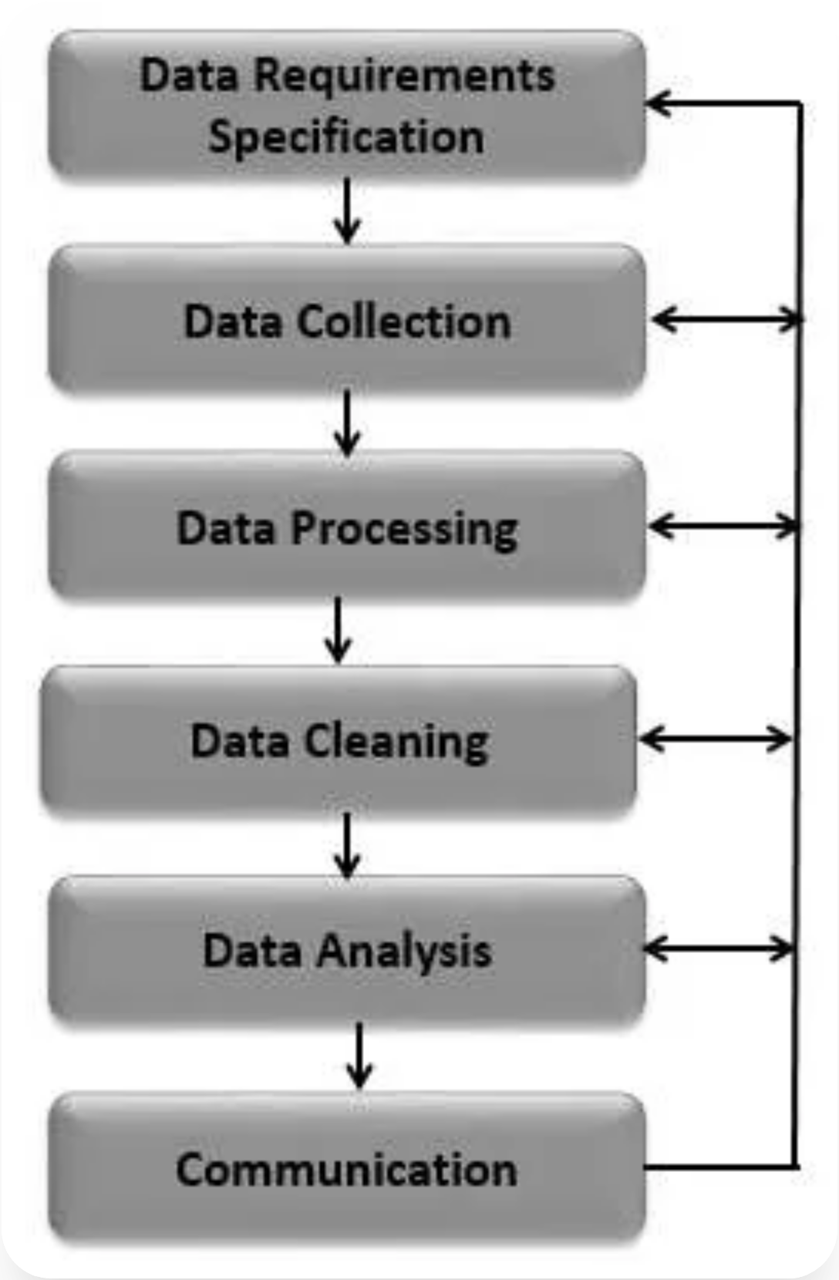

Data Collection and Preparation
Data Collection Methods
Surveys and questionnaires
Web scraping and APIs
Database queries
Sensors and IoT devices
Data Preparation Steps
Data cleaning (missing values, outliers)
Data transformation (normalization)
Feature engineering
Data integration
Data Collection and Preparation
Slide 2 of 12

Slide 3


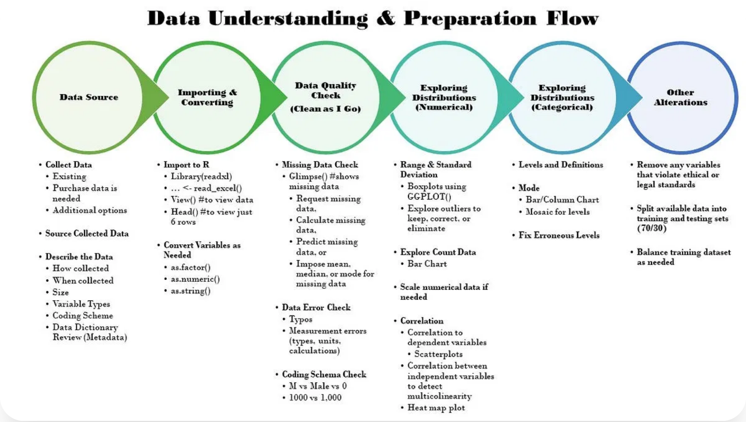

Exploratory Data Analysis
Exploratory Data Analysis (EDA) is the process of analyzing datasets to summarize their main characteristics, often using visual methods.
Key EDA Techniques
Univariate analysis (single variable)
Bivariate analysis (relationships)
Multivariate analysis (complex patterns)
Dimensionality reduction
Common Visualizations
Histograms and box plots
Scatter plots and correlation matrices
Heat maps and pair plots
Time series plots
Exploratory Data Analysis
Slide 3 of 12

Slide 4


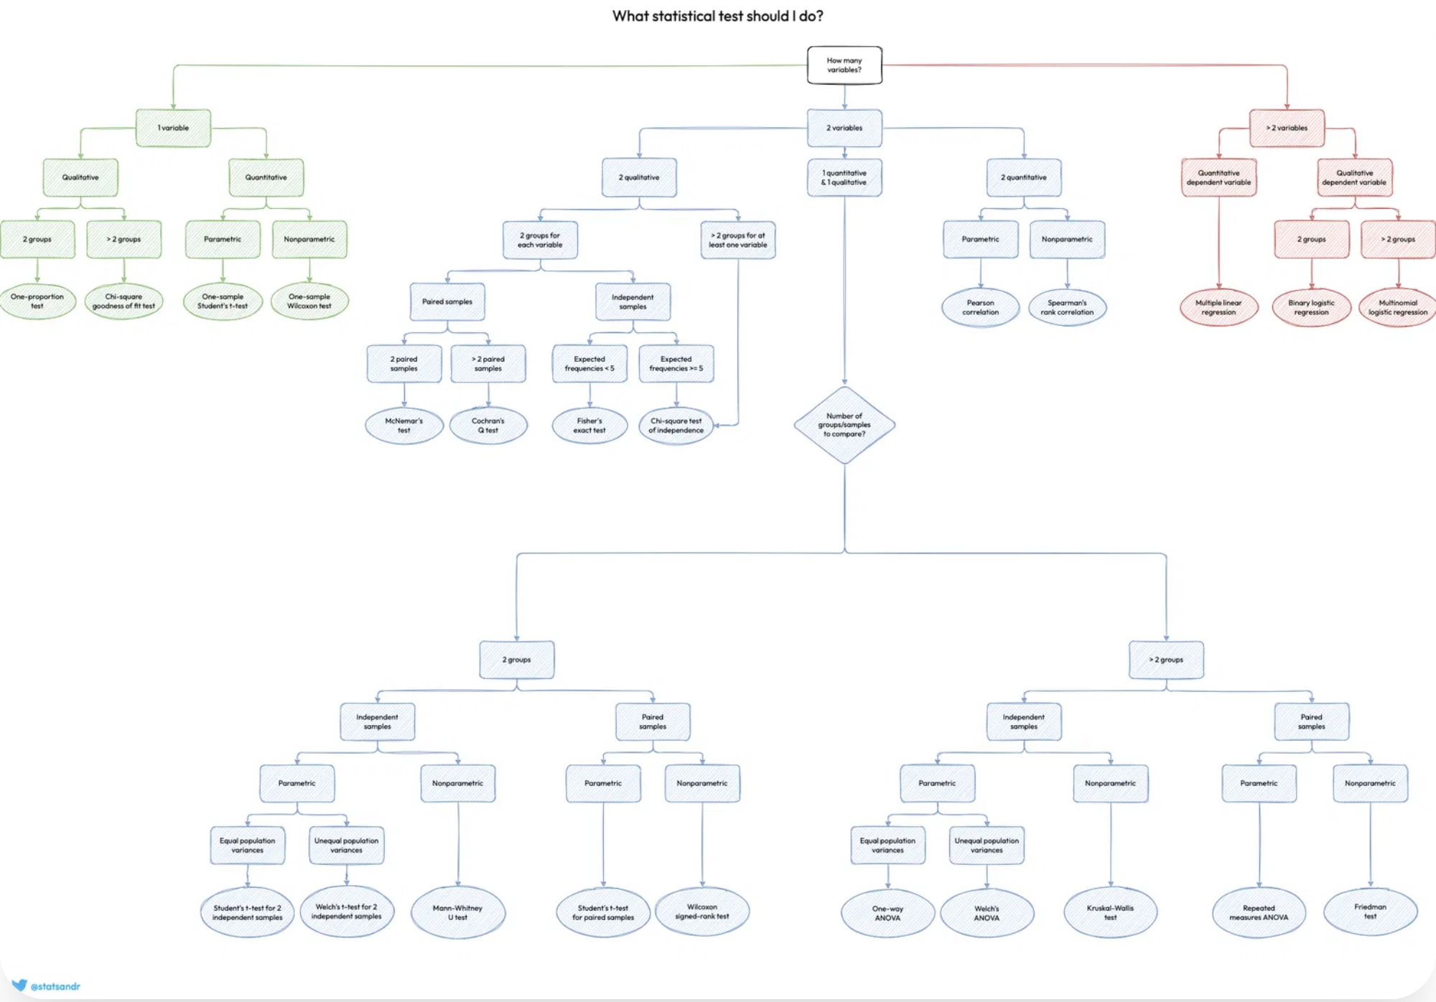

Statistical Analysis Basics
Descriptive Statistics
Measures of central tendency (mean, median, mode)
Measures of dispersion (variance, standard deviation)
Percentiles and quartiles
Distribution shapes (skewness, kurtosis)
Inferential Statistics
Hypothesis testing (null vs. alternative)
p-values and statistical significance
Confidence intervals
Statistical power and sample size
The choice of statistical test depends on data type, distribution, and research question. Use the flowchart as a guide.
Statistical Analysis Basics
Slide 4 of 12

Slide 5


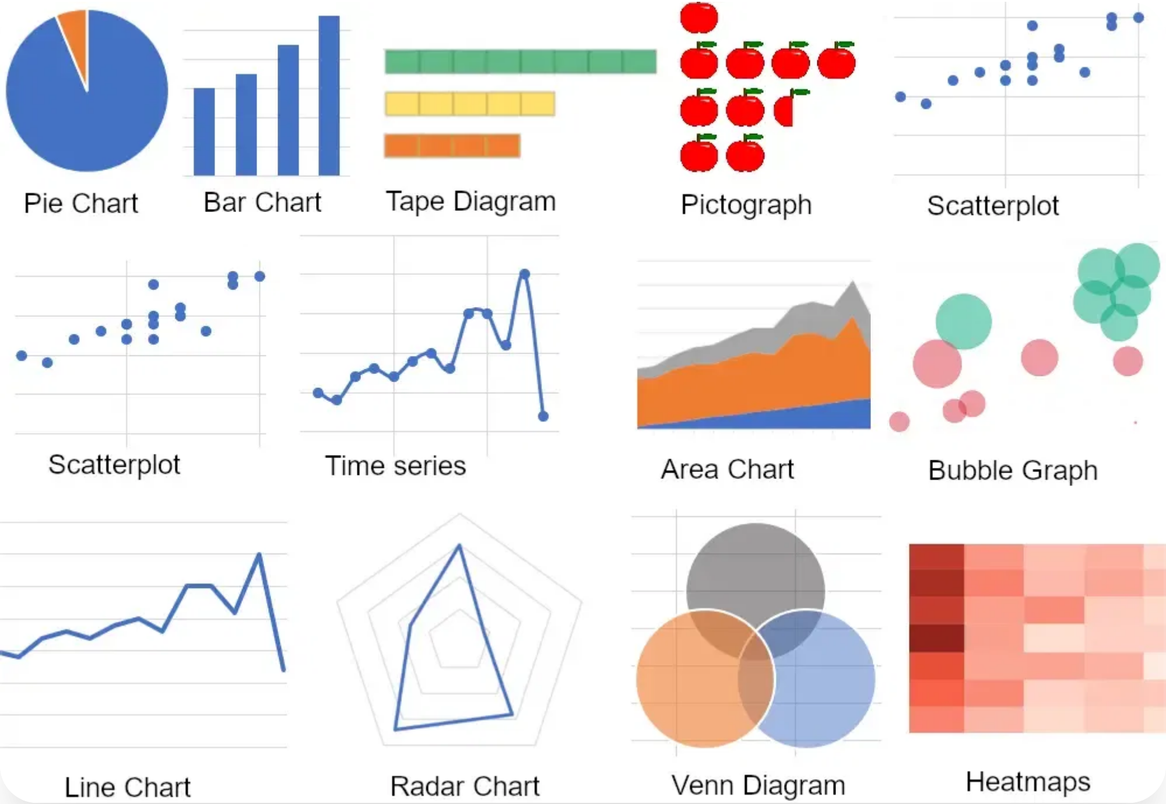

Data Visualization Techniques
Data visualization is the graphical representation of information and data, making complex data more accessible, understandable, and usable.
Common Visualization Types
Bar charts, pie charts, line graphs
Scatter plots, bubble charts
Heatmaps, treemaps
Geographic maps, network diagrams
Visualization Best Practices
Choose the right chart type for your data
Simplify and focus on the message
Use color effectively and consistently
Label clearly and provide context
Data Visualization Techniques
Slide 5 of 12

Slide 6
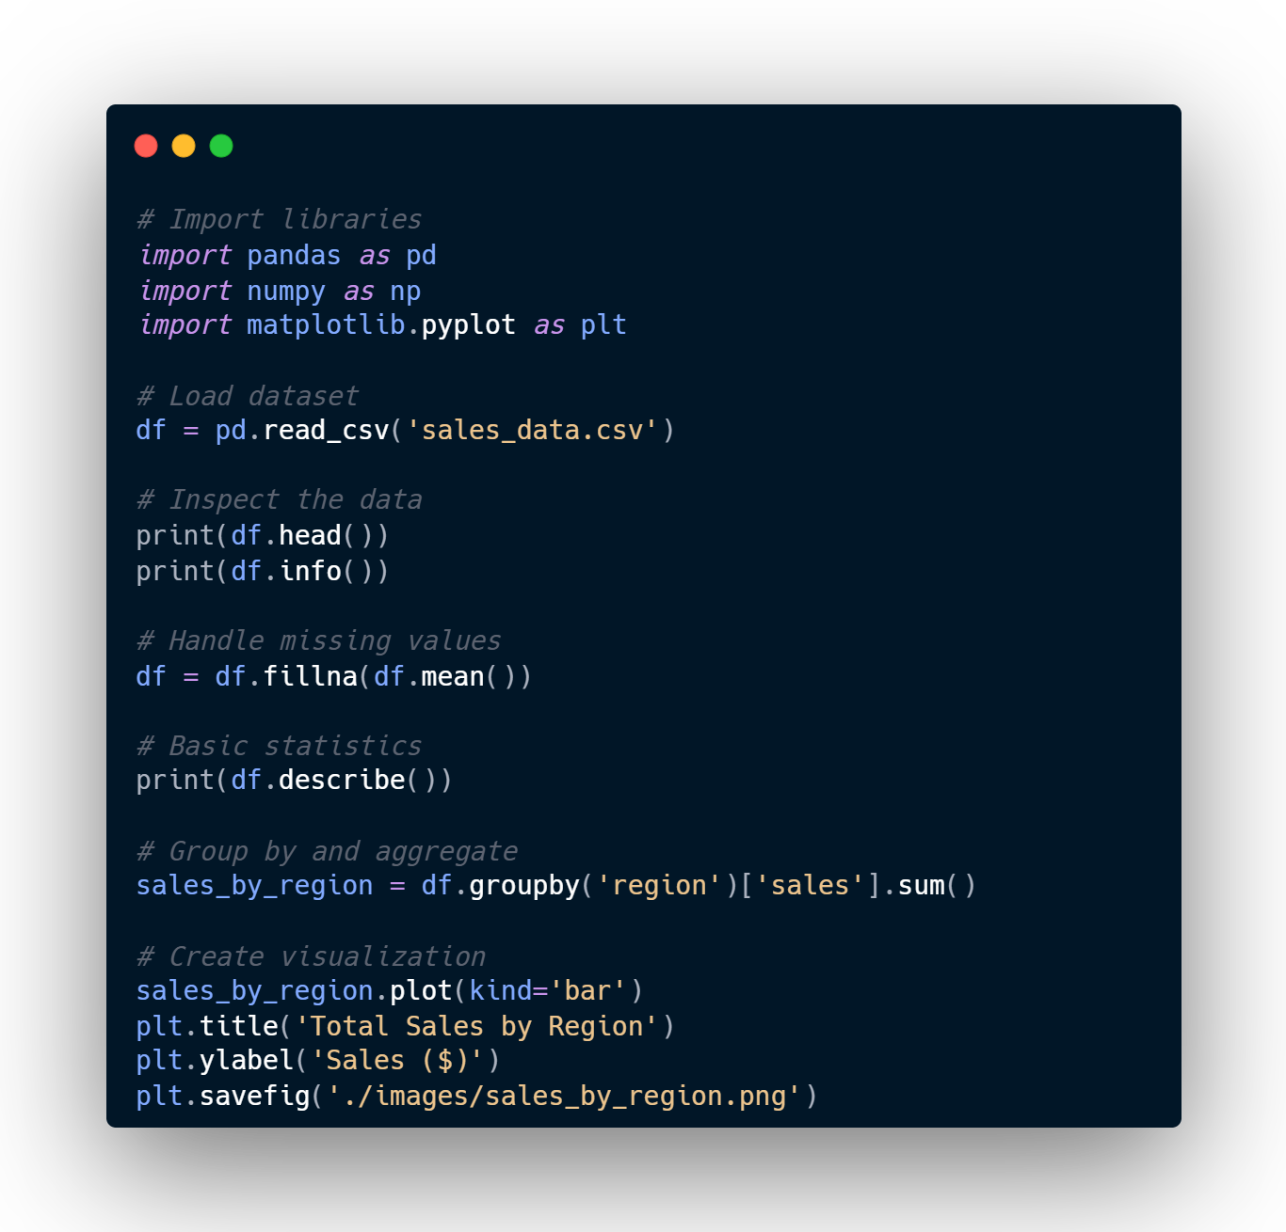



Python for Data Analysis
Python has become the leading language for data analysis due to its simplicity, versatility, and powerful libraries.
Key Python Libraries
Pandas:
Data manipulation and analysis
NumPy:
Numerical computing
Matplotlib/Seaborn:
Data visualization
Scikit-learn:
Machine learning
Common Operations
Loading and inspecting data
Cleaning and transforming data
Aggregating and grouping data
Visualizing results
Python for Data Analysis

Slide 7
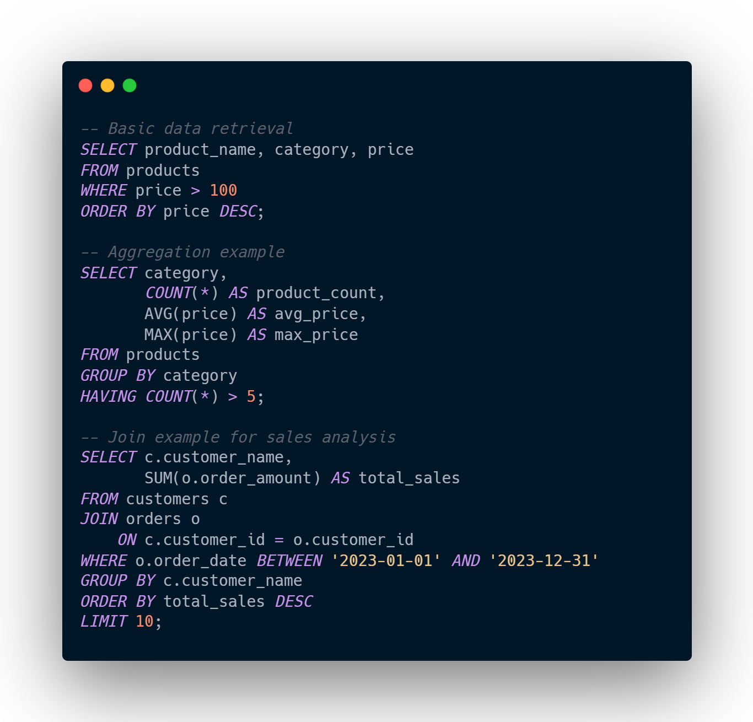


SQL for Data Analysis
SQL (Structured Query Language) is essential for extracting, transforming, and analyzing data stored in relational databases.
Key SQL Operations
SELECT:
Retrieve specific columns
JOIN:
Combine data from multiple tables
GROUP BY:
Aggregate data
WHERE/HAVING:
Filter data
SQL Analysis Benefits
Process large datasets efficiently
Perform complex joins across tables
Execute aggregations at the database level
Integrate with BI tools and dashboards
SQL for Data Analysis
Slide 7 of 12

Slide 8
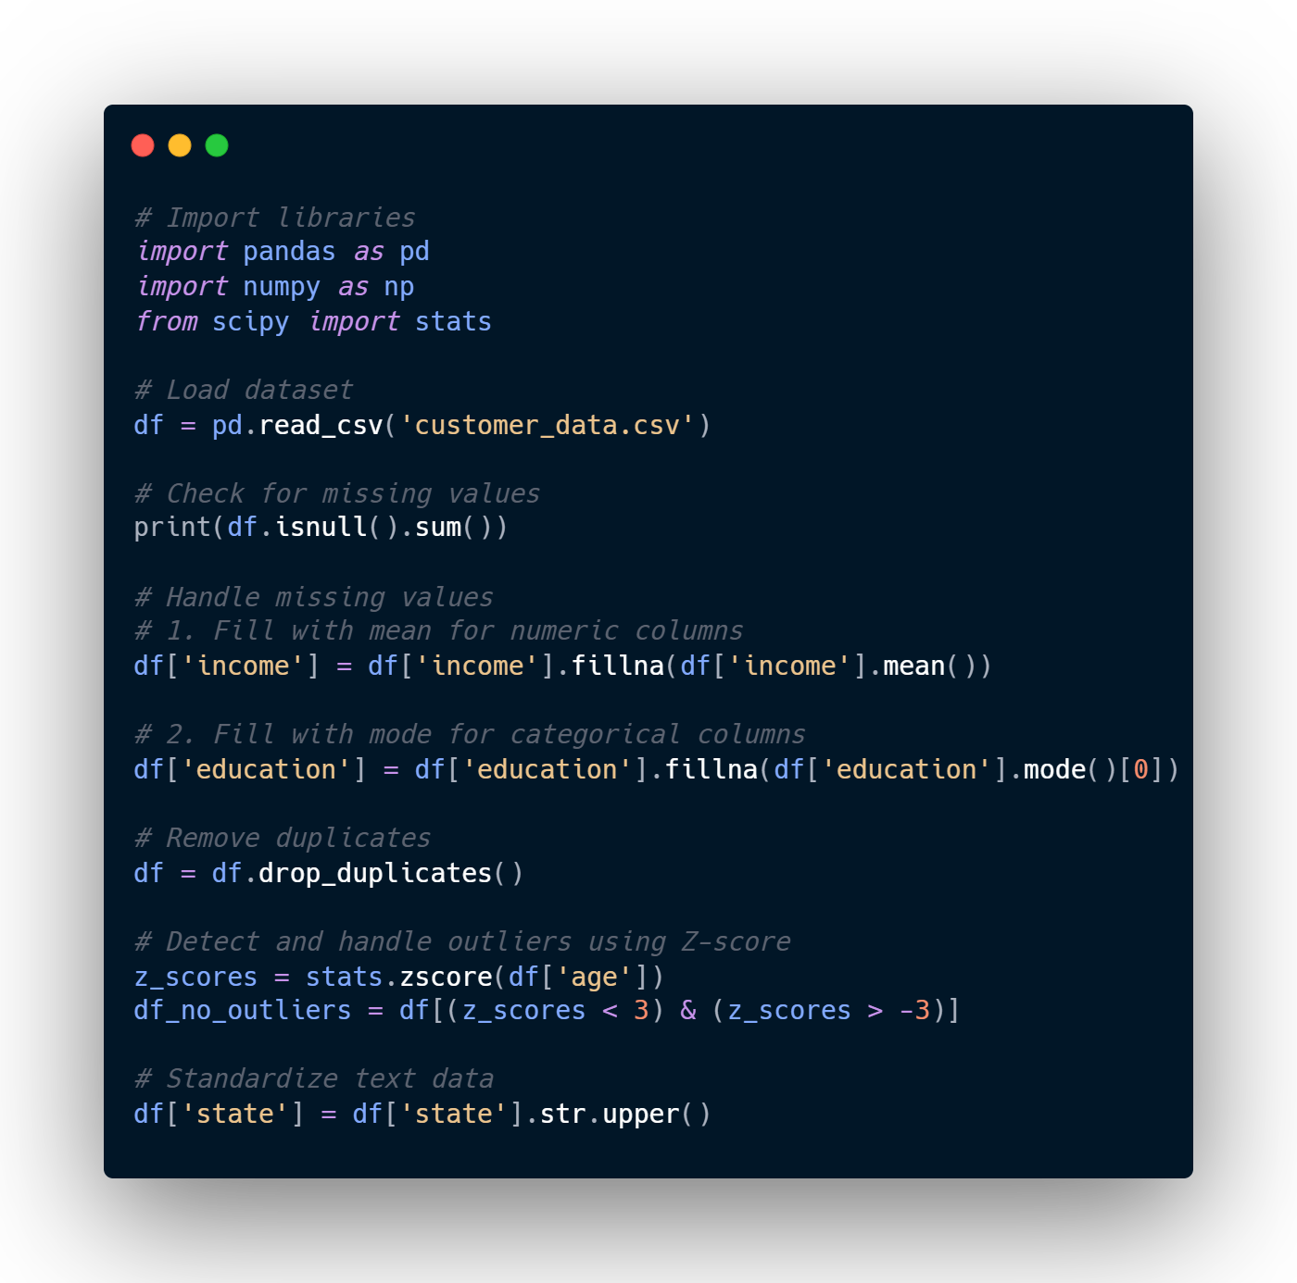



Data Cleaning Techniques
Data cleaning is the process of identifying and correcting errors, inconsistencies, and inaccuracies in datasets to improve data quality.
Common Data Issues
Missing values:
Null, NaN, or empty fields
Outliers:
Values far from the norm
Duplicates:
Redundant records
Inconsistent formats:
Dates, text, numbers
Cleaning Best Practices
Document all cleaning steps for reproducibility
Create validation rules for data quality
Automate cleaning processes when possible
Preserve original data; work on copies
Data Cleaning Techniques
Slide 8 of 12

Slide 9

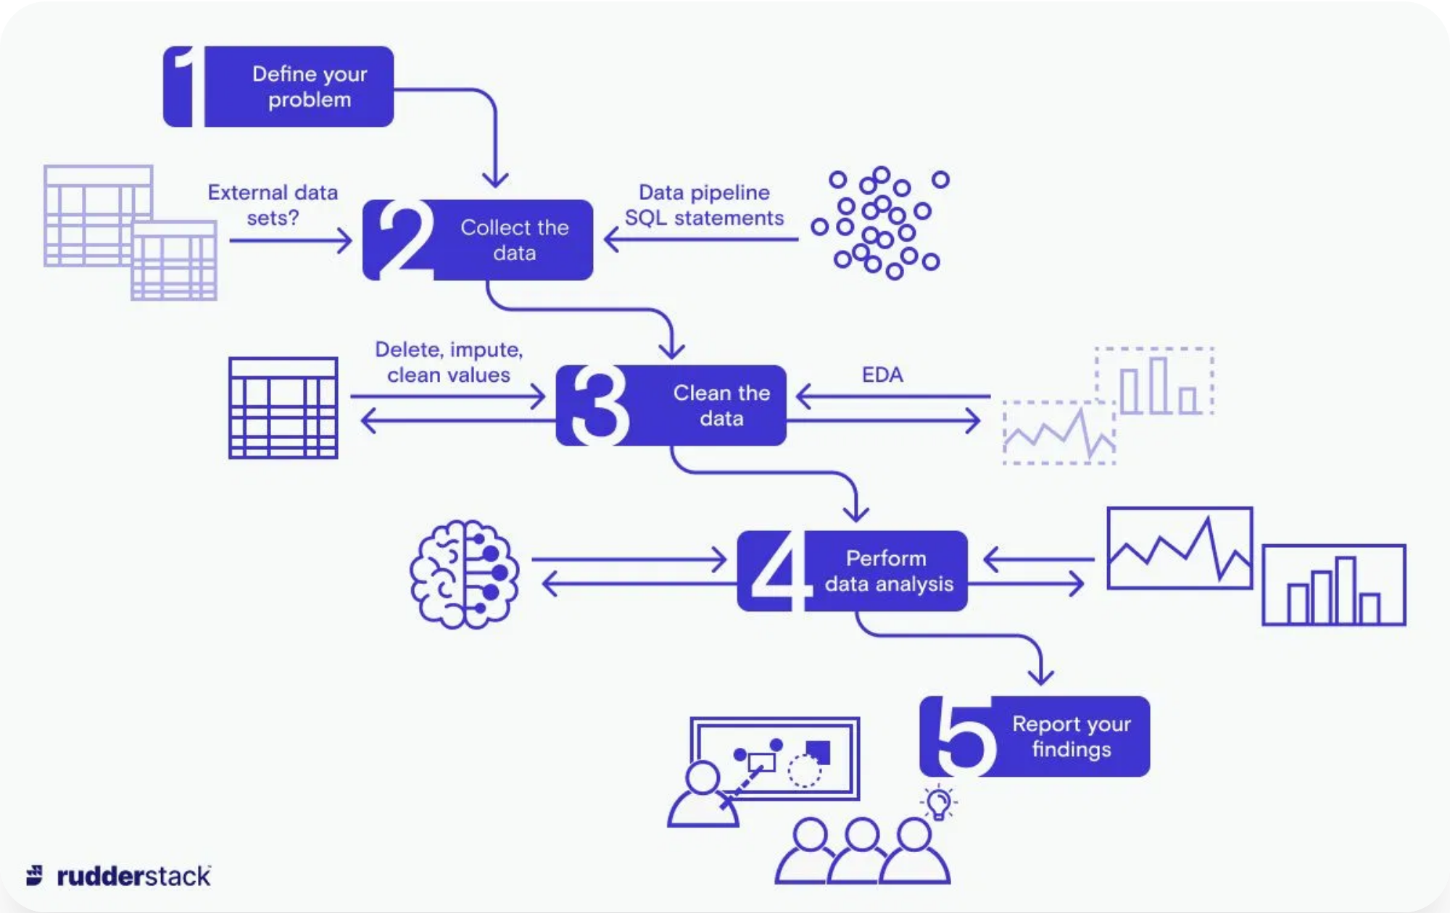
Practical Data Analysis Workflow
A structured data analysis workflow helps ensure thorough, reproducible, and efficient analysis from problem definition to insight communication.
Define the Problem
1
Clearly articulate the business question or research objective that the analysis will address.
Collect & Prepare Data
2
Gather relevant data from various sources and clean it to ensure quality and consistency.
Explore & Analyze
3
Perform exploratory data analysis, apply statistical methods, and test hypotheses.
Interpret & Communicate
4
Translate findings into actionable insights and present them effectively to stakeholders.
Practical Data Analysis Workflow
Slide 9 of 12

Slide 10


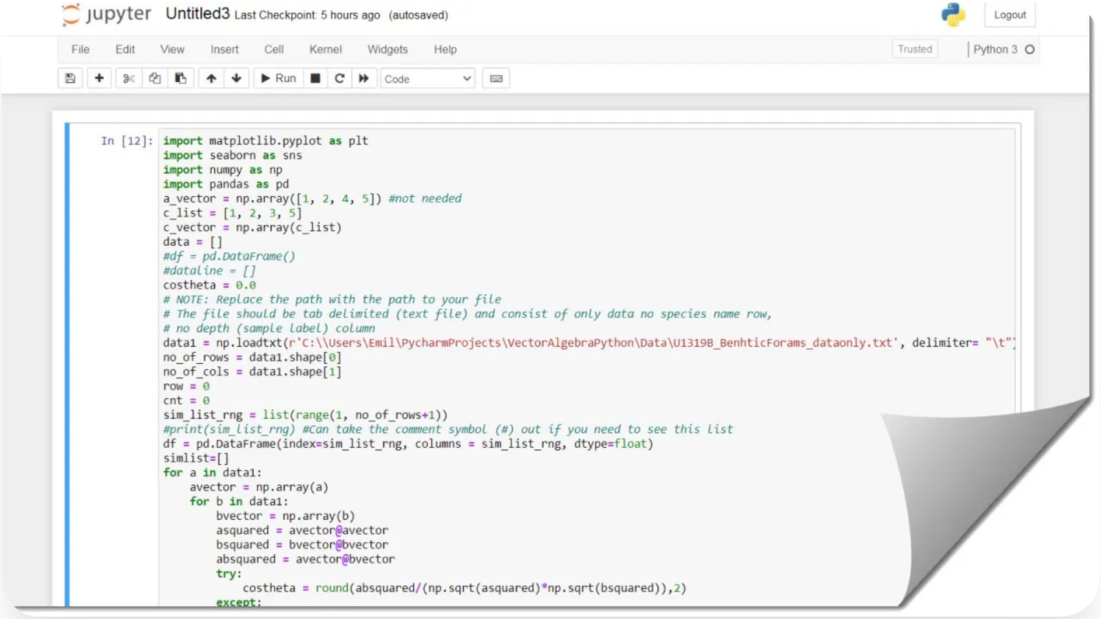

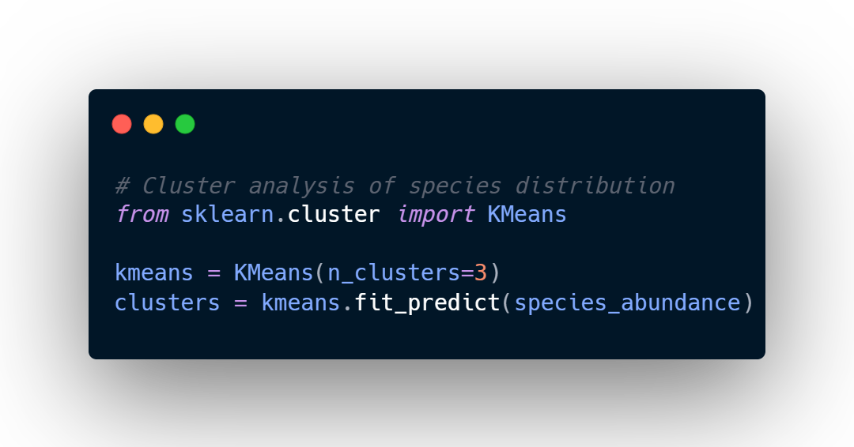

Case Study: Real-world Application
Applying data analysis techniques to solve a real-world problem: Analyzing biostratigraphic data to determine geological age and environmental conditions.
Problem Statement
Determine the age and depositional environment of rock samples based on Public Data
Analysis Approach
Used Python to analyze species distribution and abundance patterns across samples.
Results
Identified three distinct depositional environments with 92% match to radiometric dating.
Case Study: Real-world Application
Slide 10 of 12

Slide 11




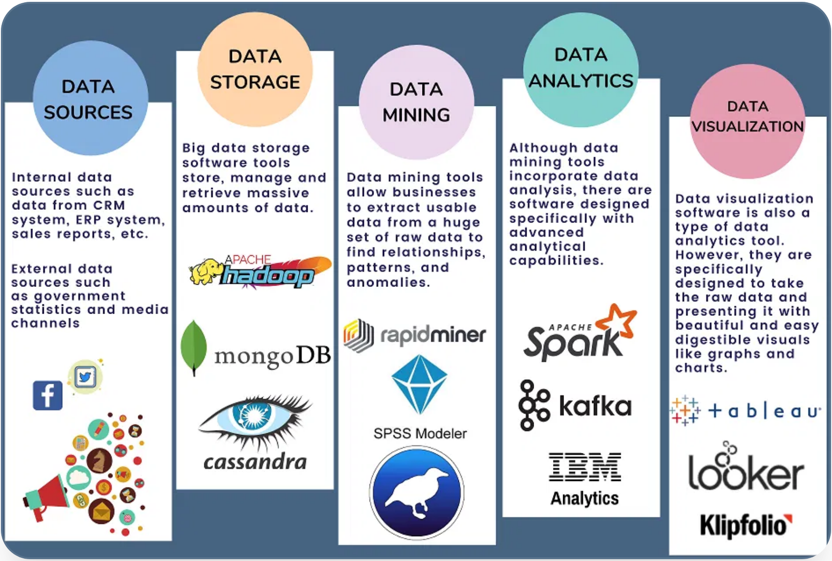






Tools and Technologies in Data Analysis
Modern data analysis relies on a diverse ecosystem of tools and technologies that support different stages of the analysis workflow.
Data Storage
Programming Languages
SQL/NoSQL databases, data warehouses, data lakes (PostgreSQL, MongoDB, Snowflake)
Python, R, SQL, Julia for data manipulation and analysis
Visualization Tools
Data Processing
Tableau, Power BI, Matplotlib, D3.js, Plotly for creating visual insights
Apache Spark, Hadoop, Pandas, Dask for handling large datasets
Machine Learning
Workflow Management
Scikit-learn, TensorFlow, PyTorch for predictive modeling
Airflow, Prefect, Dagster for orchestrating data pipelines
Tools and Technologies in Data Analysis
Slide 11 of 12

Slide 12


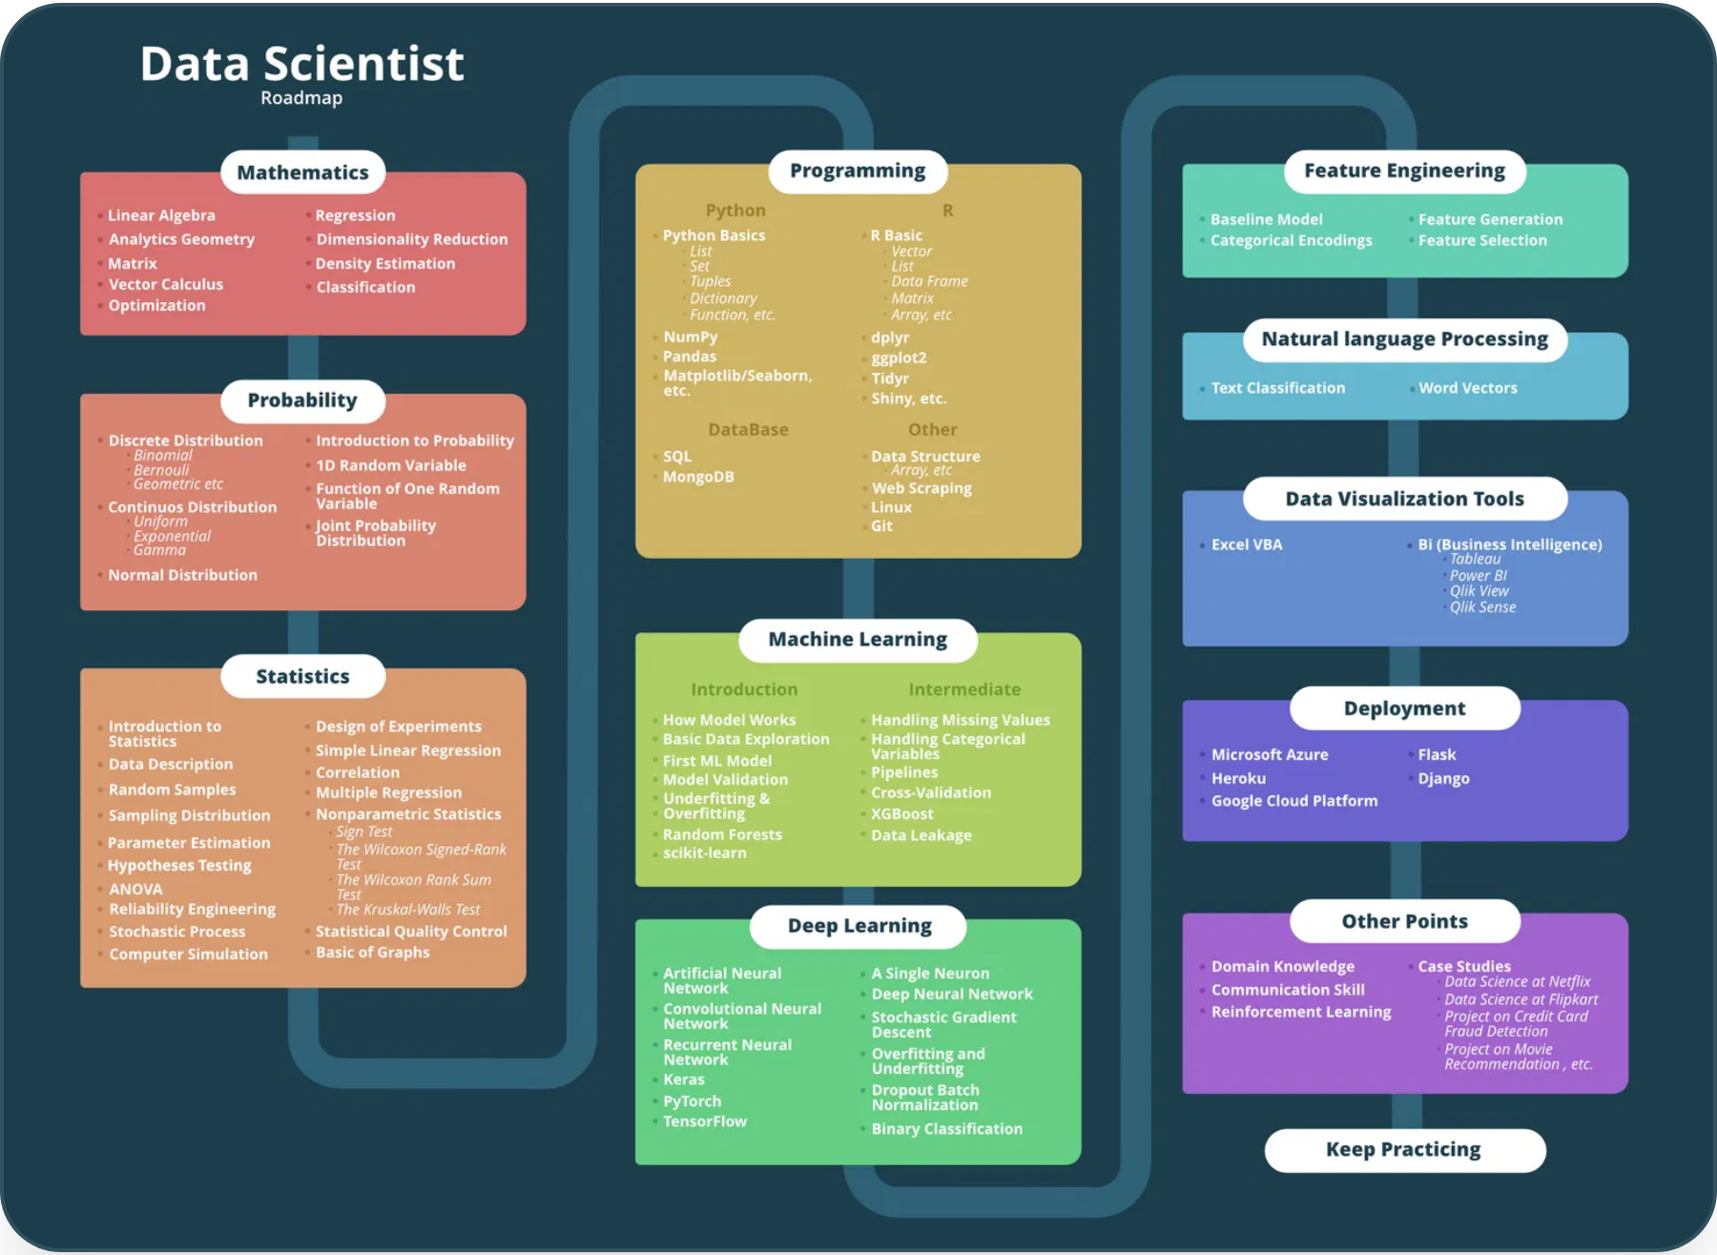





Future Learning Path and Resources
Continue your data analysis journey with these recommended resources and learning paths to build on the foundation established in this course.
Online Courses
Google Data Analytics Professional Certificate
Comprehensive program covering the entire data analysis process
IBM Data Science Professional Certificate
In-depth coverage of data science methodologies and tools
Thank you for joining us!
Technical Skills
Advanced SQL for Data Analysis
Window functions, CTEs, performance optimization
Machine Learning Fundamentals
Supervised and unsupervised learning techniques
Future Learning Path and Resources
Slide 12 of 12

